Slide 1

Study Coordinator Mtg.
09.18.24

Slide 2

Monthly Study Coordinator Meeting
Agenda – 09.18.24
Recruitment and Retention Updates
  Dr. David Johnson, Diverse VCID Recruitment Core Lead
Administrative Updates
  Claudia Ayala, Clinical Research Supervisor
  Presentation
  Dr. David Johnson, Diverse VCID Recruitment Core Lead
  Strategies to provide patient centered and definitive diagnose
Notes:
Supports and coaches outreach staff at member sites
Provides culturally competent community-based participatory research (CBPR) principles
RRC will help sites to recruit and engage participants
RRC will help sites to retain most of these participants

Slide 3

Recruitment Status as of September 18, 2024
Enrolled Participants = 1,479 (66% of overall target of 2,250)
Ethnoracial breakdown out of total enrolled to-date
    Hispanic = 398/1,479 (27%)
    White = 496/1,479 (34%)
    AA/Black = 585/1,479 (40%)
  Ethnoracial breakdown out of total target goal of 750/ethnicity
    Hispanic = 398/750 (53%)
    White = 496/750 (66%)
    AA/Black = 585/750 (78%)

Slide 4

Period 4 – Additional Recruitment Commitments
Admin has reached out to all sites about additional recruitment commitments as we move into Period 4.
Please continue to press forward on Diverse recruitment as NINDS has granted us more recruitment time to meet our goal.

Slide 5

DVCID ADMIN CORE UPDATES:
We have received the Period 4 award
Clinical sites subawards will be processed when the Period 4 award is fully executed. It is currently at UCD Sponsored Programs Office. Stay tuned!
P4 Subaward covers the period: 09/01/2024 – 08/31/2025

Slide 6
Monthly Science Meeting Series
Starting this Fall, we will have monthly meetings where DVCID investigators will present updates on their research involving data sets and/or sample analyses.
Site PIs, coordinators, lab personnel, are welcome to attend and join the Core leaders, investigators and NINDS.
  Our DVCID Admin team has added site PI’s, coordinators, and lab personnel to our list serve: diversevcidsciencemeetingseries@groups.ucdavis.edu
  The meetings will be held on a Tues each month, 11am-12pm PST, depending on availability.

Slide 7
Meetings Scheduled This Fall:
Meeting Date/Time | Presenter | Topic/Title
10/22/2024 11am-12pm, PST | Dr. Mark Sanderson-Cimino (UCSF) | Development and validation of a harmonized memory score for multicenter Alzheimer’s disease and related dementia research
11/05/2024 11am-12pm, PST | Dr. Johannes Weickenmeier (Stevens Institute of Technology/University of Oxford) | Long-term Brain Shape Changes As a Marker for Accelerated Aging

Slide 8
Data Completion Reports
Currently our Admin Core is asking sites about the following:
Data Type | DVCID Admin Core Contact | Frequency of queries
UDS data sets | Lupe | Monthly
Questionnaire, Clinical Lab, Learning Tasks, MRI, Samples shipped info | Morgan | Quarterly

Slide 9
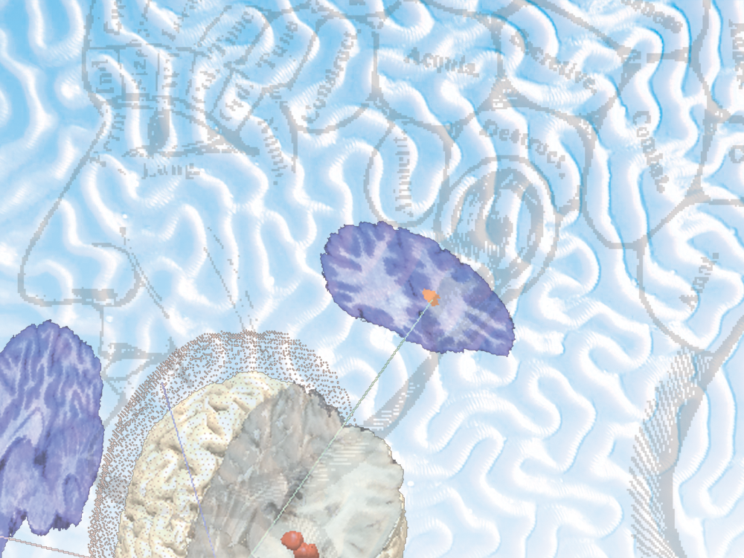

Strategies to Provide Patient Centered and Definitive Diagnosis
David K. Johnson, PhD.
Alzheimer’s Disease Research Center a NIH center of excellence at the
University of California - Davis
DVCID Monthly Study Coordinator Meeting September 18, 2024

Slide 10

The Many Causes of Dementia
  Alzheimer’s disease (60% to 80% of dementia cases)
  Vascular disease
  Lewy body disease
  Frontotemporal degeneration
  Progressive supranuclear palsy
  Cortical basilar degeneration
  Creuztfeldt Jakob disease
  Autoimmune Dementia
  Pseudodementia/ reversible conditions

Slide 11
Causes of Dementia
Vascular
Dementia
10%
Frontotemporal
Dementia: 5%
Other
Dementia
With Lewy
Bodies: 15%
Alzheimer’s
Disease
50 - 70%

Slide 12
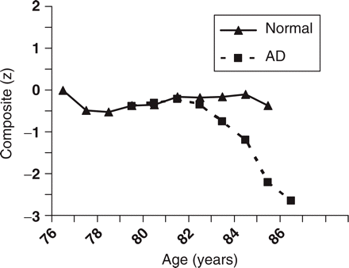
The Traditional Perception of Alzheimer’s Disease:
Longitudinal performance on a composite of cognitive test scores by two men of similar age and education
Figure taken from Storandt (2008); Sample reported by Galvin et al. (2005)

Slide 13
Alzheimer’s Disease Cognitive Decline
Clinical syndrome
  Decline from previous level of ability in at least 2 areas of thinking
    Memory
    Language impairment
    Visuospatial problems
    Executive deficits (reasoning, problem solving)
  Cause loss of independence in activities of daily living (no longer able to manage finances, medications, etc.)
  Course characterized by gradual onset and progressive decline

Slide 14
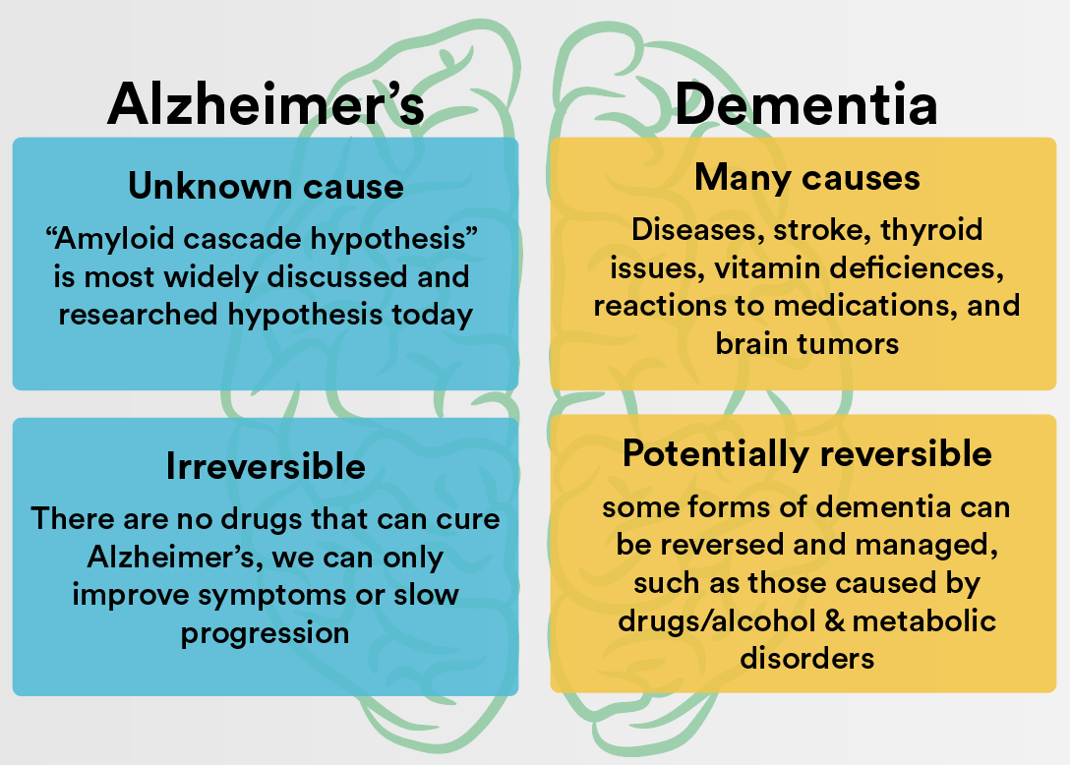
Alzheimer’s vs. Dementia

Slide 15

Alzheimer’s Disease is a
Public Health Imperative

Slide 16
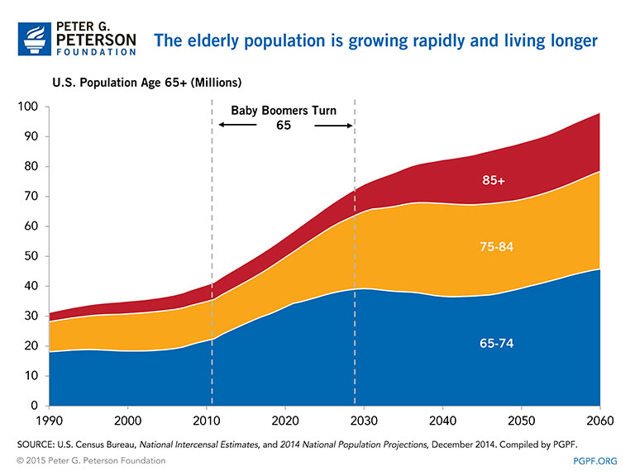

Slide 17
Brain Atrophy
In our mid-30s, we begin to lose about -0.4% of our brain annually.
Reflects loss of neurons and shrinkage of neurons
AD associated with x2 rate of brain atrophy
  2% per year in AD vs. 1% in nondemented controls
  Brain atrophy rate reflective of AD pathology burden.
Notes:
17

Slide 18
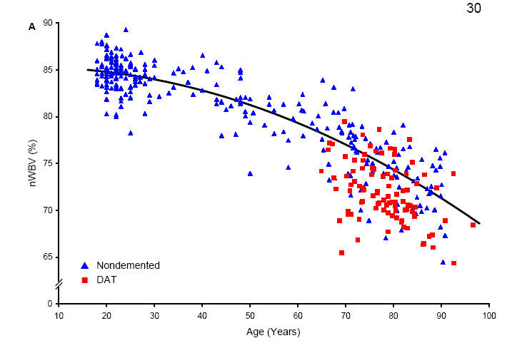
Brain size declines with Age & Alzheimer’s
Fotenos et al, 2004

Slide 19
Normal Aging ?
Fotenos et al, 2004

Slide 20
Pathological Aging
Fotenos et al, 2004

Slide 21
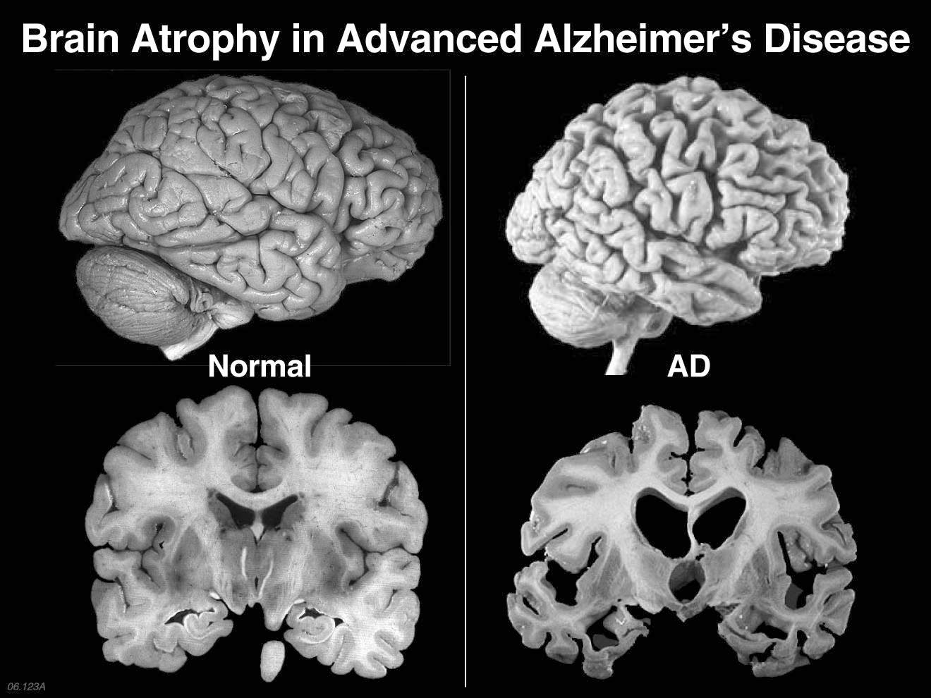
Global atrophy of the brain

Slide 22
Pathological Aging
Fotenos et al, 2004
Notes:
Aging is complex
Must be aware of what changes in memory are associated with normal aging
Normal Aging = slight and progressive decrease in intellectual abilities and memory performance
Abnormal Aging = Dementia,
an increased rate of decline in intellectual abilities and memory performance
Deterioration in memory and thinking that goes beyond the changes expected to occur with the normal aging process.

Slide 23

Notes:
Individuals who care for people with Alzheimer’s disease are often told to ‘take care of yourself’ yet receive little direction regarding how to do this.
Spouses of people with Alzheimer’s disease are especially at risk because chronic health conditions like heart disease, depression, smoking, and physical disabilities are made worse by the caregiving burden.
EXCESS MORBIDITY! CG Stress = Sig Risk for DEATH
How do we gives caregiver tools to take care of themselves?
1) We know that understanding dementia behavior ➔ Un-Complicates grief process that goes along with caregiver burden
2) BUT What are other self-care tools needed for the AD caregiver?

Slide 24
Is detecting cognitive decline at a wellness visit all that important?
There are so many other chronic diseases that need to be tracked!

Slide 25
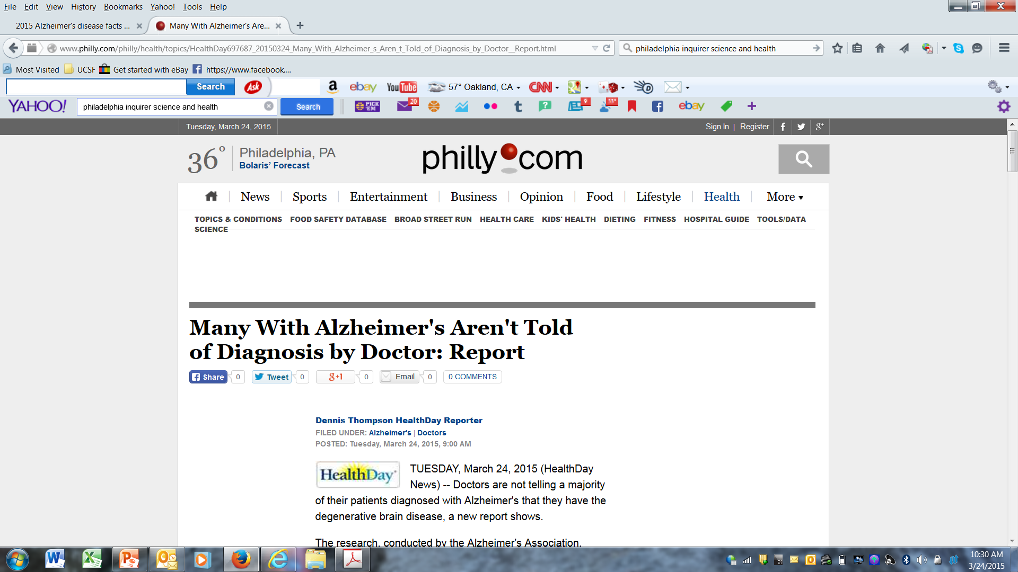
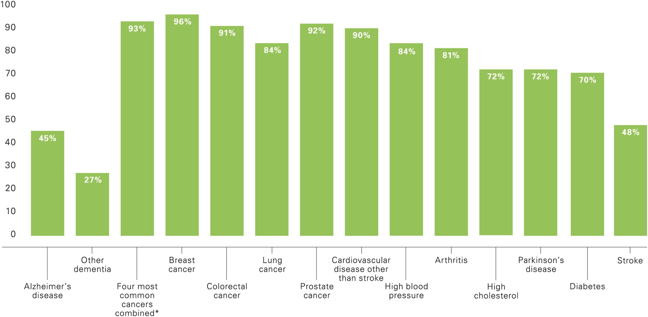
Alzheimer's & Dementia: 2015 11:332-384

Slide 26
Difficult Clinical Decisions:
Staging & Morbidity
15-20min Clinical Reality
Clinician must prioritize
Hard decisions
  Training
  MD personal beliefs
  Who is the Pt
How do you spend your precious time - What diagnostic baby must go overboard?

Slide 27
Myths @ Disclosure / Treatment
No efficacious treatments so why imbue pt & family with anxiety about an inescapable future decline?
Aging is decline – Can’t avoid it
Helplessness of Clinician → Patient
Passive Ageism

Slide 28
Difficult Clinical Decisions:
Staging & Morbidity
We KNOW that cognitive decline LEADS functional decline and increase
    ALL cause morbidity
    YLD
THUS cognitive decline should be a primary question to be ruled out during every geriatric wellness visit

Slide 29
Public Health Implication
Delaying the onset of AD by 5 years could cut AD incidence by 50% and reduce the US health care burden by $50 billion annually
Until disease-modifying AD therapies are available, risk-reduction will remain the cornerstone of efforts to curb new incidence

Slide 30
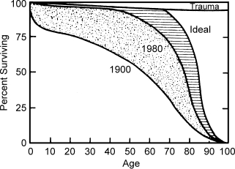
Goal = Compress Morbidity
The Compression of Morbidity
James Fries
IOM 1982
Notes:
Averaged survival curves

Slide 31
Effect of Medications on AD Course
Cognitive Abilities
Initiate Medications
Aricept
Razadyne
Exelon
Cholinesterase
inhibitors
Namenda
Time
Notes:
Idiographic – single person’s hypothetical model of an survival
Cholinesterase inhibitors increase the neurotransmitter Acetylcholine in synaptic cleft.
Namenda / memantine is believed to block preferentially excessive extrasynaptic activity of the N-methyl-D-aspartate (NMDA) subtype of glutamate receptors (NMDAR),
while largely sparing normal synaptic NMDAR activity. Targets abnormal NMDA hyper sensitivity.

Slide 32
Goal = Early Therapeutic Interventions!
Initiate Medications
Aricept
Razadyne
Exelon
Cholinesterase
inhibitors
Namenda
Decrease YLD

Slide 33
Myths @ Disclosure
DEBUNKED
Pts are experiencing symptoms
  Symptoms are changing QOL
  Reduced: Independence, Marital, Functional
Dx confirms the elephant in room
HIGHLY unusual to cause catastrophic rx
  (when happens the rx is usually related to preexisting duress or psychiatric illness)
Most of time = RELIEF; Give a name to a mysterious change in life

Slide 34
Knowing Root Cause
Empowers the family to speak frankly about the disease and EOL planning
  Gives permission for caregiver to break from previous roles
  New beginning to creating a dignified end
  Planning the future EOL requires thoughtful planning – a cognitive capacity that is fleeting
  Critical to begin earlier than later

Slide 35
Planning
Disability rising as dementia progresses
  Cognitive
  Physical
  NeuroPsychiatric
  Exacerbate existing conditions
Meet challenges with new tools
  Social Services
  Supportive Therapies
  Respite care for caregiver
  PT/OT

Slide 36
Goal
Planning should focus on
  Supporting CG
  Maximizing pt function
Result = Compression of morbidity

Slide 37
Stage Theories of AD are
Diagnostic Conveniences
(double edged sword )
Notes:
Precautionary tale

Slide 38
Mild Cognitive Impairment (MCI)
Transition from Normal Cognition to Dementia
Normal Cognition
Mild Cognitive Impairment
Dementia
Notes:
Most people do not have a straight road to dementia

Slide 39
MCI and AD
The presence of MCI is associated with elevated risk of dementia
~10-15% of people with MCI will develop AD each year
80% aMCI will convert to AD in-the-long-run
Not all people with MCI develop AD (some stay stable or improve)
Monitor over time

Slide 40
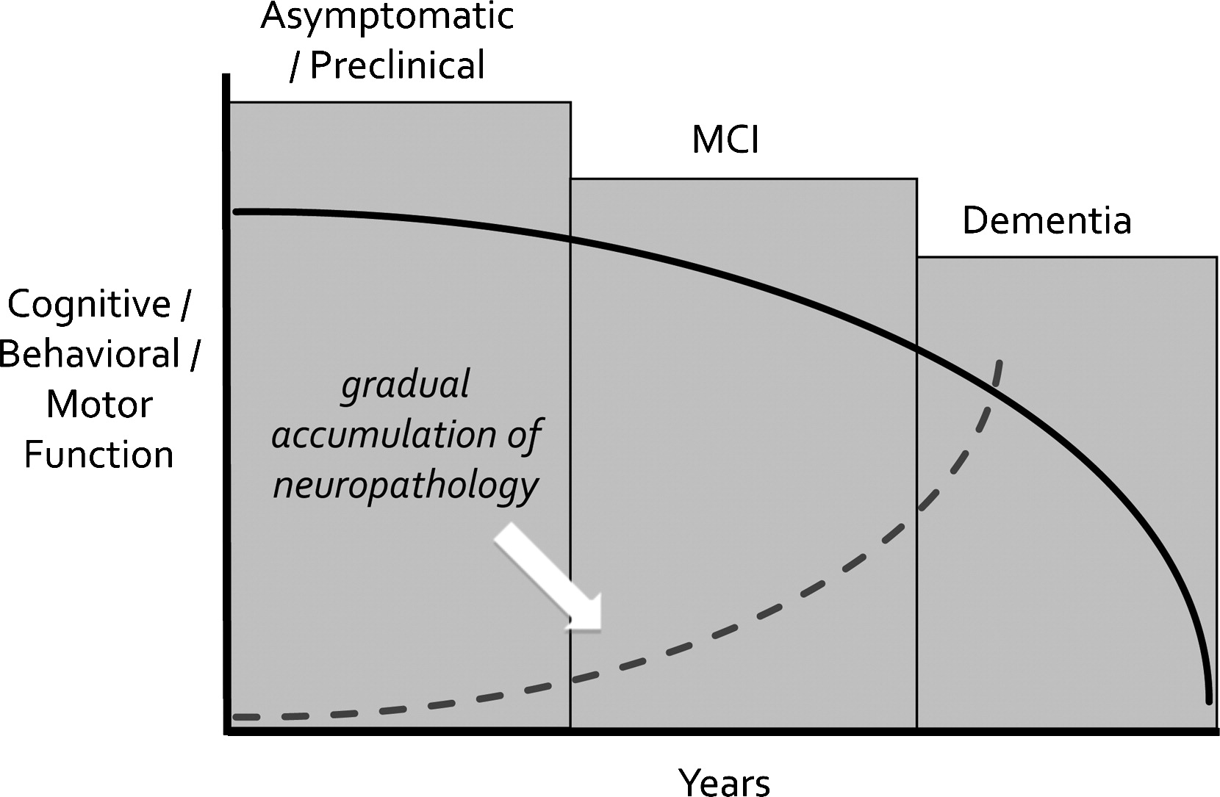
What is mild cognitive impairment?
Definition: often a single, subtle cognitive impairment (e.g., memory impairment) for which the individual is still able to compensate in their daily life
Often, but not always, a precursor to AD or other form of dementia
Notes:
Stage theories give docs & pts a false sense of deterministic decline
Profile of decline over time is stereotypical But the RATE at which one declines can be affected
Stage theory is a diagnostic convenience that can be used either…
Fatalistically = Decline will occur
Optimistically = Rate of decline can be changed for the better
Gradual decline is HIGHLY PREFERRED = Compression of morbidity

Slide 41
Strategies for Success
Secondary Preventive Medicine:
  Sensitivity of Diagnostics
  Time
  Expertise

Slide 42
The Diagnostic Work-Up
  History (from patient and informant)
  Neurological examination
  Imaging (CT, MRI)
  Cognitive/Neuropsychological tests
  Lab work (CBC, comprehensive metabolic panel, thyroid function, vitamin B12 level)
  * In many cases PCPs complete this process but in certain circumstances a specialist is required

Slide 43
CA SB833 Funded in 2016
One time augmentation of CADC budget
Directives
  Determine standard of care in early, accurate diagnosis
  Targeted outreach to health professionals
  Endorse and disseminate low-cost, accessible detection and diagnosis tools
  Address health disparities within diverse population
  Evaluate effectiveness and measure impact

Slide 44
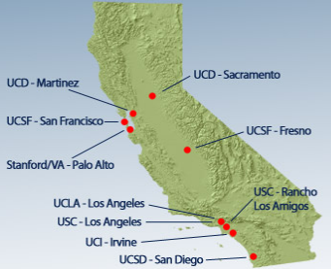
Bigger vision: CADC Community Network
Community physicians/practices
  “Certified” dementia assessment practices
Network for training
  Annual Conferences
    SoCal, NoCal
  Lecture referral service
Network for referral
CADC
CADC
CADC
CADC
CADC
CADC
CADC
CADC
CADC
CADC
CADC
CADC
CADC

Slide 45
THANK YOU !
David K. Johnson, PhD.
Alzheimer’s Disease Research Center a NIH center of excellence at the
University of California - Davis
Dignity Health - Clinic and Medical Leadership Forum – December 14th 2017

Slide 46
Reminder:
Please make sure to attend our monthly Repository Core Meeting next Wed. September 25 from 10 – 10:50am, PST
  Site representation is important!

Slide 47
UC Davis Team Contact List:
Type of Question | Contact Name | Role | Email
General/Reporting Issue/ Eligibility/Data Entry | Claudia Ayala Guadalupe Flores-Marin Morgan Tate | Clinical Research Supervisor, Admin Core Project Admin Assistant Clinical Research Analyst | ceayala@ucdavis.edu gfloresmarin@ucdavis.edu mbtate@ucdavis.edu
Reporting Issue | Gina Giambruno Dr. Charles DeCarli | Health Educator, Recruitment Core Director, Alzheimer's Disease Research Center, Admin Core | ggiambruno@ucdavis.edu cdecarli@ucdavis.edu
Recruitment & Retention | Dr. David Johnson Gina Giambruno Taylor Clardy | Professor, Recruitment Core Health Educator, Recruitment Core Marketing Specialist 2 | ggiambruno@ucdavis.edu dkj@ucdavis.edu thclardy@ucdavis.edu
Study Supplies/Shipping | Jeannine White Jacob Conston Ramses Denis-Romero | Biomarker Core Manager SRA, Repository Core SRA, Repository Core | jlmcgee@UCDAVIS.EDU dvcid-repository-core@ucdavis.edu
Invoicing/Sub-award | Emily Crivello Morgan Tate Rani Asato Claudia Ayala | Clinical Research Analyst Clinical Research Analyst Finance Manager Clinical Research Supervisor | ecrivello@ucdavis.edu mbtate@ucdavis.edu rkasato@ucdavis.edu ceayala@ucdavis.edu
UCD IRB (IRBNet) | Kelly Wallace | Clinical Research Supervisor, IRB | klwallace@ucdavis.edu
MRI | Dr. Audrey Fan | MRI Team Lead | apfan@ucdavis.edu

Slide 48
UC Davis Recruitment and Retention Core Contacts
David K. Johnson, PhD.
Professor in Neurology
Director, UC Davis ADC - East Bay
PI, Dementia & Diabetes Prevention Project
100 N. Wiget Lane, Suite 150
Walnut Creek, CA 94598
dkj@ucdavis.edu
Gina Giambruno, MPH, MCHES®
Health Educator 4
UC Davis Alzheimer’s Disease Center
4860 Y Street, Suite 3900
Sacramento, CA 95817
ggiambruno@ucdavis.edu/diversevcid@ucdavis.edu

Slide 49
Co-investigators
Dr. Hector M. González
Professor
University of California, San Diego
Dept of Neurosciences, School of Medicine
Dr. Lisa L. Barnes
Professor
Rush University
Department Neurological Sciences
Dr. Raina Croff
Professor of Neurology at the NIA Layton Aging and Alzheimer's Disease Center at Oregon Health & Science University

