Slide 1

Study Coordinator Meeting
02.15.23

Slide 2

Monthly Study Coordinator Meeting
Agenda – 02.15.23
Administrative Core Updates
  LONI-MRI Participant IDs
  Site Reimbursement Updates
  Data Entry
  Transportation fee arrangement
  Reminder: Email questionnaires to participants
  FAQ Section
Recruitment Goals
Celebrate Black History Month
Notes:
Supports and coaches outreach staff at member sites
Provides culturally competent community-based participatory research (CBPR) principles
RRC will help sites to recruit and engage participants
RRC will help sites to retain most of these participants

Slide 3

Administrative Updates
Monthly Coordinator Meeting
02/15/2023

Slide 4
Site Reimbursement Statement
Contact: Colleen Burke-Pitts
cburkepitts@ucdavis.edu
All site reimbursement statements for Year 1 (9.1.21 – 8.31.22) have been emailed to sites.

Slide 5
Invoicing Updates
Site Reimbursement Statements
Yr 1:
  Expecting payment soon: 5 sites
  Pending receipt of required backup documentation: 5 sites
Yr 2 Q1:
  Will send to sites after Yr 1 payments are submitted
  Aiming to rely on site self-reporting AND on data entered on the data portal
  Will schedule individual meetings with sites to review the process to ensure questions are addressed promptly.

Slide 6

Data Entry on the Data Portal
Per the OSMB:
Data needs to be entered in a timely manner.
For invoicing purposes:
Recommend entering data within 2 weeks of the study visit – whenever possible!
Data Portal reports accessed quarterly will reflect the site’s activities
Sites will be paid based on:
  the site activity captured on the data portal, which is reflected on these reports
  Self-reporting: (e.g. Chart screening, coordinator salary, etc.)

Slide 7
Transportation Cost
The study is adding $50 to the sites' budgets to cover transportation costs
  Sites may choose to use it toward participant payment OR toward any other means of transportation currently in use to enable participants to complete their visits (e.g. driver cost, Uber health, etc.)
  Sites should maintain their internal record of subject payment, but UC Davis will not require it for invoicing.
  Sites’ sub-awards and in some instances, ICFs will need to be revised
    The UC Davis team will contact sites individually and notify them when the additional transportation funds will take effect.

Slide 8
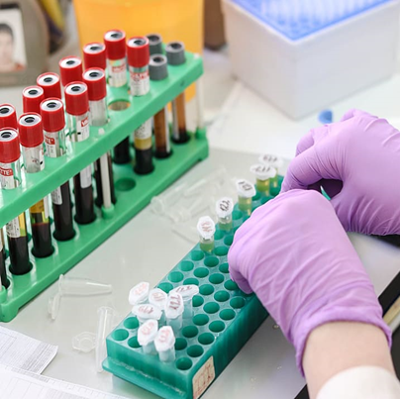
Reminder from our Repository Team:
Diverse VCID Repository Core Monthly Meeting:
Wednesday, February 22, 2023
10:00 AM-10:50 AM, PST
https://ucdavishealth.zoom.us/j/92291277633?pwd=cmxEM3dCQjA0cEszNVdSMnl6VmZtdz09
At least 1 member from each site MUST be in attendance!

Slide 9
Communication with the UC Davis Team:
Type of Question | Contact Name | Role | Email
General/Reporting Issue/ Eligibility | Claudia Ayala | Clinical Research Supervisor, Admin Core | ceayala@ucdavis.edu
Reporting Issue | Gina Giambruno Dr. Martha Forloines Dr. Charles DeCarli | Health Educator, Recruitment Core Director of Clinical Research, Admin Core Director, Alzheimer's Disease Research Center, Admin Core | ggiambruno@ucdavis.edu mrforloines@ucdavis.edu cdecarli@ucdavis.edu
Recruitment & Retention | Gina Giambruno Dr. David Johnson | Health Educator, Recruitment Core Professor, Recruitment Core | ggiambruno@ucdavis.edu dkj@ucdavis.edu
Study Supplies/Shipping | Kelsey Erickson Daniel Salvagni | Repository Manager, Repository Core Junior Specialist, Repository Core | kelerickson@ucdavis.edu djsalvagni@ucdavis.edu
Invoicing/Sub-award | Colleen Burke-Pitts Yuliya Yarova-Yarovaya Claudia Ayala | Administrative Assistant Finance Manager Clinical Research Supervisor | cburkepitts@ucdavis.edu yarovaya@ucdavis.edu ceayala@ucdavis.edu
UCD IRB (IRBNet) | Kelly Wallace Talia Grayce Hamm | Clinical Research Supervisor, IRB Clinical Research Coordinator, IRB | klwallace@ucdavis.edu tghamm@ucdavis.edu

Slide 10
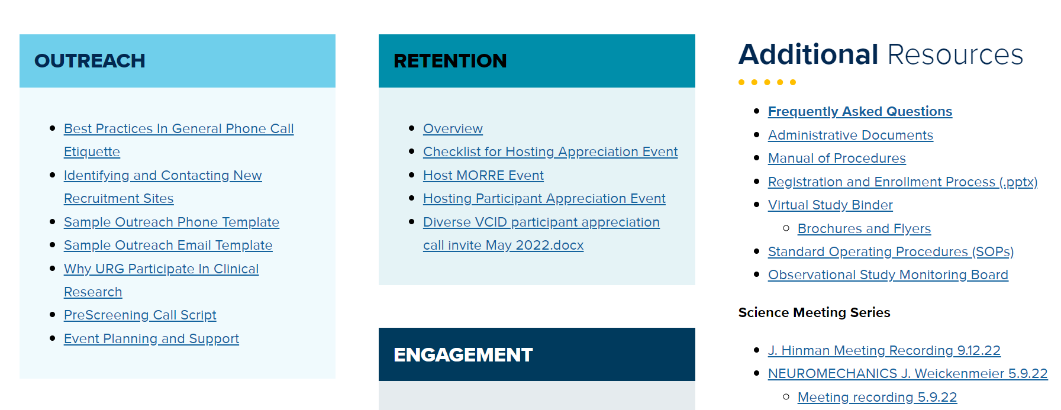
Diverse VCID FAQs
Feel free to reach out to Claudia Ayala (Clinical Research Supervisor) with questions: ceayala@ucdavis.edu.

Slide 11
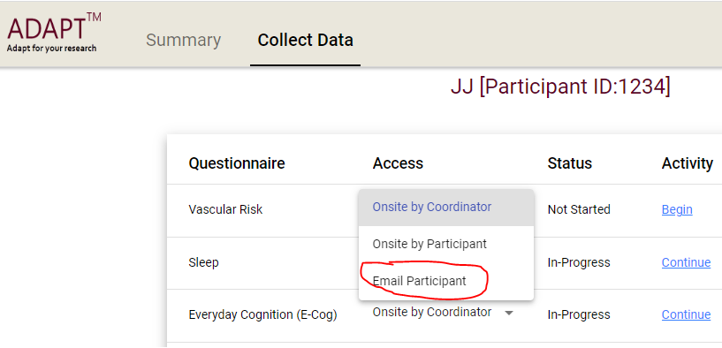
Data Portal – Email Questionnaires

Slide 12
Trivia Question –
Win $50 Visa Gift Card
Q: How many teeth does an adult human have?
A: ?

Slide 13
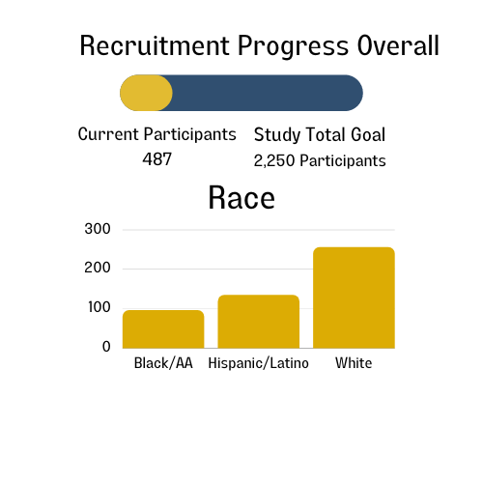

OVERALL Recruitment Goals and Progress (as of 02.14.2023)
UCD, UCSD, UTH SCSA, UofM, Columbia, PENN, Wake Forest, WI, Johns Hopkins, KY & USC (11)
Welcoming the following sites to the Diverse team soon: Indiana University, South Alabama, UT Houston (3)

Slide 14
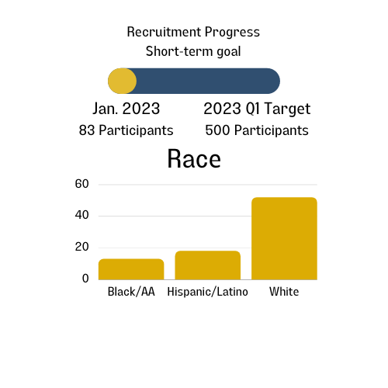

Q1 2023 Recruitment Goals and Progress (as of 02.14.2023)
UCD, UCSD, UTH SCSA, UofM, Columbia, PENN, Wake Forest, WI, Johns Hopkins, KY & USC (11)
Welcoming the following sites to the Diverse team soon: Indiana University, South Alabama, UT Houston (3)

Slide 15
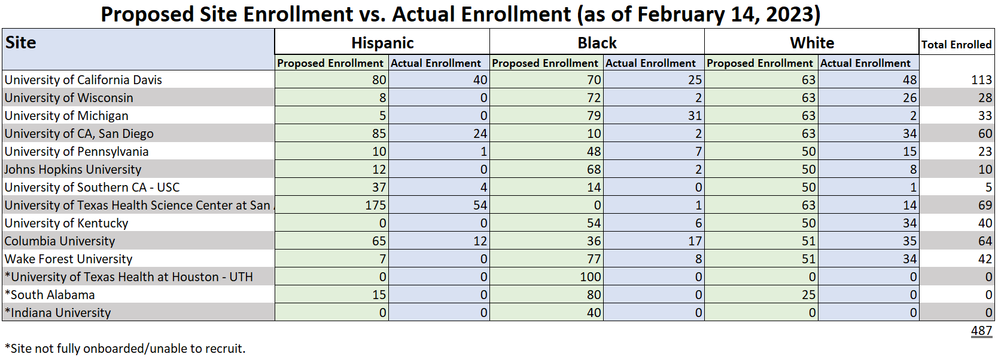
Proposed vs. Actual Enrollment (Updated 02.14.23)

Slide 16
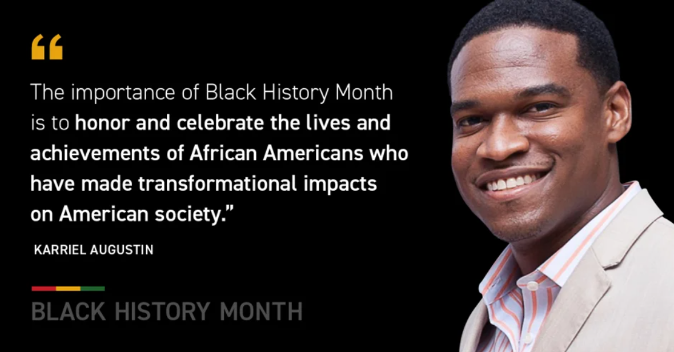
Collected data on enrollment (as of November 14, 2022)
Site | MRI | Labtests | Biofluids | Learning Tasks | UDS | Questionnaires
UC Davis | 56% | 66% | 67% | 48% | 34% | 31%
UTH-San Antonio | 0% | 62% | 2% | 6% | 0% | 8%
UC San Diego | 67% | 80% | 74% | 77% | 0% | 88%
Columbia | 36% | 79% | 81% | 83% | 2% | 81%
Wake Forest | 52% | 36% | 60% | 24% | 0% | 72%
UofM | 47% | 0% | 0% | 0% | 26% | 63%
UPENN | 0% | 82% | 76% | 82% | 12% | 76%
Wisconsin | 0% | 86% | 0% | 64% | 21% | 79%
Kentucky | 0% | 75% | 88% | 44% | 0% | 69%
Johns Hopkins | 20% | 40% | 40% | 40% | 40% | 80%
USC | 0% | 100% | 0% | 0% | 0% | 0%

Slide 17
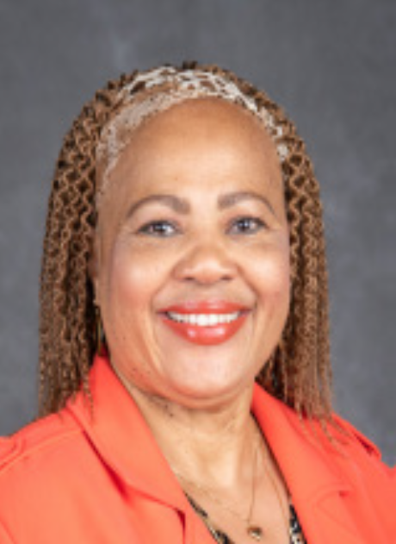

Lytonia Floyd – Outreach Specialist

Slide 18

General Announcements

Slide 19
Qualtrics Survey Results
Compared to one year ago, training and supplies are a non-issue – significant change and index for good recruitment, necessary but not sufficient.
We ran into troubles with transportation four months ago and through the survey the problem was identified site-by-site which informed our creative solution and that’s now being executed.
Co-enrollment as a strategy to incentivize recruitment is working. All sites are carefully monitoring participant burden but are clearly prioritizing Diverse VCID recruitment. This is true for almost all sites.
Upon our instructions to focus on co-enrollment in the short term, about half of the centers have not started recruiting new participants to replenish depleted cohorts.
By result, marketing and advertising resources are underutilized.
Diverse VCID staff have done a good job training the collaborating site staff. Collaborating sites know where to find resources (100%). The most used resource is the MOORE Toolbox, followed by the Study Coordinator Meetings. Individual documents that are necessary to download can be found quickly and efficiently.
IDENTIFIED PROBLEM: There are “pieces” of people working on a complex recruitment pipeline that inhibits instrumental recruitment. Sites need help orchestrating from beginning to end, the whole recruitment pipeline. This problem probably results from being understaffed or new to research. The percent effort dedicated to Diverse doesn’t support understanding of the complete recruitment lifecycle.

Slide 20
We need your help….
We’d like each site to provide one or two willing participants to participate in a podcast
  Please send names/numbers/emails of interested participants to: ggiambruno@ucdavis.edu
Please send Study Coordinator(s) picture, title and center name for the infographic for participants to: ggiambruno@ucdavis.edu

Slide 21
UC Davis Recruitment and Retention Core Contacts
David K. Johnson, PhD.
Professor in Neurology
Director, UC Davis ADC - East Bay
PI, Dementia & Diabetes Prevention Project
100 N. Wiget Lane, Suite 150
Walnut Creek, CA 94598
dkj@ucdavis.edu
Gina Giambruno, MPH, MCHES®
Health Educator 4
UC Davis Alzheimer’s Disease Center
4860 Y Street, Suite 3900
Sacramento, CA 95817
ggiambruno@ucdavis.edu/diversevcid@ucdavis.edu

Slide 22
Co-investigators
Dr. Hector M. González
Professor
University of California, San Diego
Dept of Neurosciences, School of Medicine
Dr. Lisa L. Barnes
Professor
Rush University
Department Neurological Sciences
Dr. Raina Croff
Professor of Neurology at the NIA Layton Aging and Alzheimer's Disease Center at Oregon Health & Science University

