Slide 1

Study Coordinator Meeting
12.21.22

Slide 2

Monthly Study Coordinator Meeting
Agenda – 12.21.22
Administrative Core Updates
  Introduction of Claudia Ayala
  Site Reimbursement Report/Invoicing
Recruitment Goals
General announcements/discussions
Sensis updates
Notes:
Supports and coaches outreach staff at member sites
Provides culturally competent community-based participatory research (CBPR) principles
RRC will help sites to recruit and engage participants
RRC will help sites to retain most of these participants

Slide 3
Site Activity Report/Invoicing Process
Contact: Colleen Burke-Pitts
cburkepitts@ucdavis.edu
Invoicing Process Flow!
Site Activity Reports being processed for Year 1
(9/1/2021 through 8/31/2022)

Slide 4
Diverse VCID Budget Period for invoicing
Year 1 Clinical Site Invoicing | Year 2 Clinical Site Invoicing (aka NCE of Year 1)
Q1 9/1/2021- 11/31/2021 | Q1 9/1/2022- 11/31/2022
Q2 12/1/2021-2/28/2022 | Q2 12/1/2022-2/28/2023
Q3 3/1/2022-5/31/2022 | Q3 3/1/2023-5/31/2023
Q4 6/1/2022-8/31/2022 | Q4 6/1/2023-8/31/2023

Slide 5
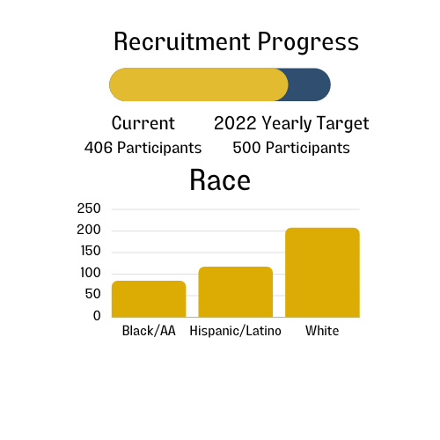

Recruitment Goals and Progress (as of 12.20.2022)
UCD, UCSD, UTH SCSA, UofM, Columbia, PENN, Wake Forest, WI, Johns Hopkins, KY & USC

Slide 6
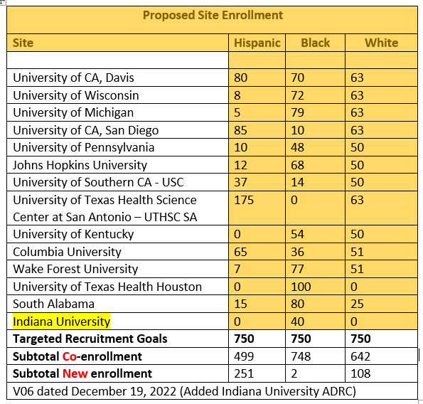
Proposed Site Enrollment
(V6 updated 12.19.22)

Slide 7
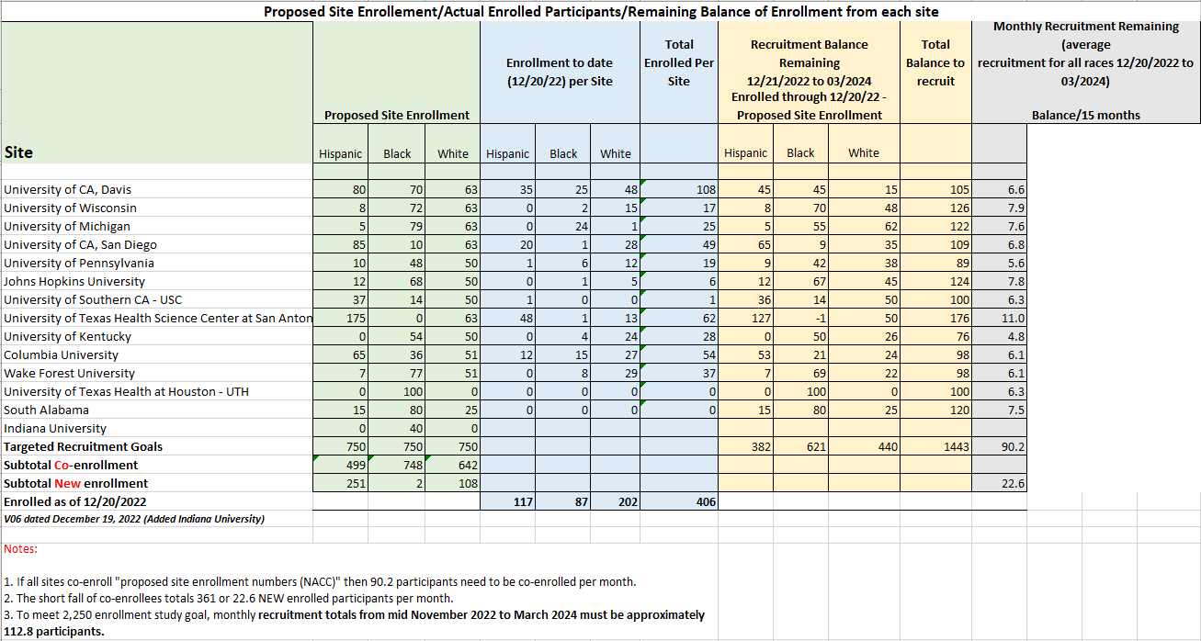
Proposed Site Enrollment/Actual Enrolled Participants/Remaining Balance of Enrollment from each site

Slide 8
2022 Short-term Goals
2022 Yearly Target Goals = 500 Participants
500 – 406 = 94
94/11 sites = 8.5 more participants/site
5 working days until the end of the year!
Don’t let up!!!
Overall goal = 2,250 participants (750 Hispanic/Latino, 750 Black, 750 White)

Slide 9

General Announcements

Slide 10
We’d love to hear from each site…..
We’d like each site to provide one or two willing participants to participate in a podcast
  Please send names/numbers/emails of interested participants to: ggiambruno@ucdavis.edu
Please send Study Coordinator(s) picture, title and center name for the infographic for participants to: ggiambruno@ucdavis.edu

Slide 11
We’d like each site to…..
Hold an in-person participation appreciation
Please send Study Coordinator(s) picture, title and center name for the infographic for participants to: ggiambruno@ucdavis.edu

Slide 12
UC Davis is working on….
Onboarding three new sites
Compiling Sensis media campaign results (what worked, what didn’t) for best practices in recruiting
Feedback on onboarding new staff
Ways to reimburse for transportation
Cultural Humility Speaker for January 18, 2023 Meeting

Slide 13
Transportation Barrier Information Needed
UC Davis needs more information to address the transportation barrier.
Qualtrics survey being sent TODAY (12/21/22).
Please take 5-8 minutes to complete this survey.

Slide 14
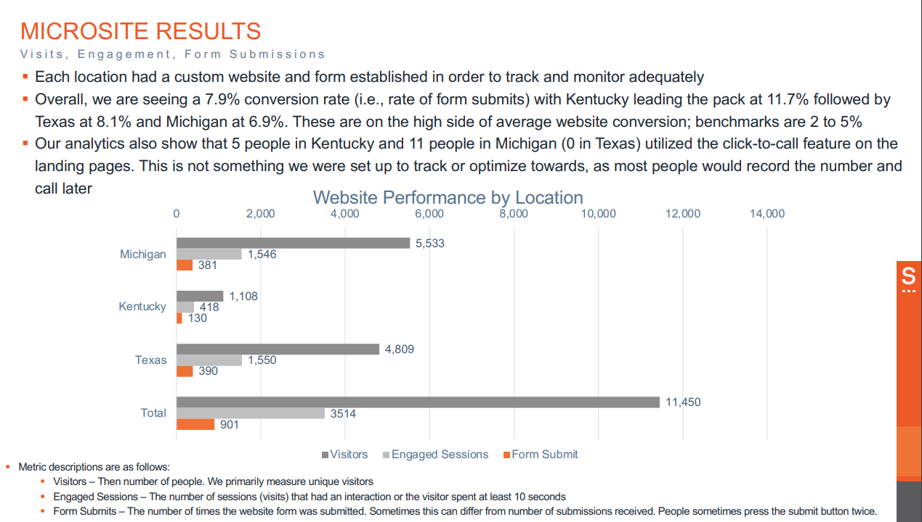
Sensis Media Campaign Results
(Pilot ended October 31, 2022)

Slide 15
UC Davis Recruitment and Retention Core Contacts
David K. Johnson, PhD.
Professor in Neurology
Director, UC Davis ADC - East Bay
PI, Dementia & Diabetes Prevention Project
100 N. Wiget Lane, Suite 150
Walnut Creek, CA 94598
dkj@ucdavis.edu
Gina Giambruno, MPH, MCHES®
Health Educator 4
UC Davis Alzheimer’s Disease Center
4860 Y Street, Suite 3900
Sacramento, CA 95817
ggiambruno@ucdavis.edu/diversevcid@ucdavis.edu

Slide 16
Co-investigators
Dr. Hector M. González
Professor
University of California, San Diego
Dept of Neurosciences, School of Medicine
Dr. Lisa L. Barnes
Professor
Rush University
Department Neurological Sciences
Dr. Raina Croff
Professor of Neurology at the NIA Layton Aging and Alzheimer's Disease Center at Oregon Health & Science University

