Slide 1

Study Coordinator Meeting
12.15.21

Slide 2

Monthly Study Coordinator Meeting
Agenda – 12/15/21
Administrative Core Updates and Q&A
Question from 11/17/21 Meeting
Diverse VCID website resources walk-through
  For Researchers->Resources
  Videos
  Data Portal
  Additional Resources
  Study Coordinator Resources
  Screening Log – get paid
Reminders
Notes:
Supports and coaches outreach staff at member sites
Provides culturally competent community-based participatory research (CBPR) principles
RRC will help sites to recruit and engage participants
RRC will help sites to retain most of these participants

Slide 3

Getting Started!

Slide 4
Are You Ready?
Data Portal
Training
Subaward
IRB
MTA
MRI
Blood Processing

Slide 5
IRB Reliance

Slide 6

Administrative Questions Please contact:
Jennifer Jarrett
Email: jjjarrett@ucdavis.edu or DiverseVCID@ucdavis.edu

Slide 7
Questions/comments from 11/17/21 Meeting:
  Q: If a newly recruited participant is interested in the Diverse study, but does not want to be followed in a longitudinal study for life, can they just be enrolled in Diverse VCID?
  A: Yes, but when only enrolling someone in Diverse VCID and not in your cohort, make sure on the NACC UDS form A1 question #5 - you select option 2 “Subject is supported primarily by a non-ADC study (e.g., R01, including non-ADC grants supporting FTLD Module participation).”

Slide 8
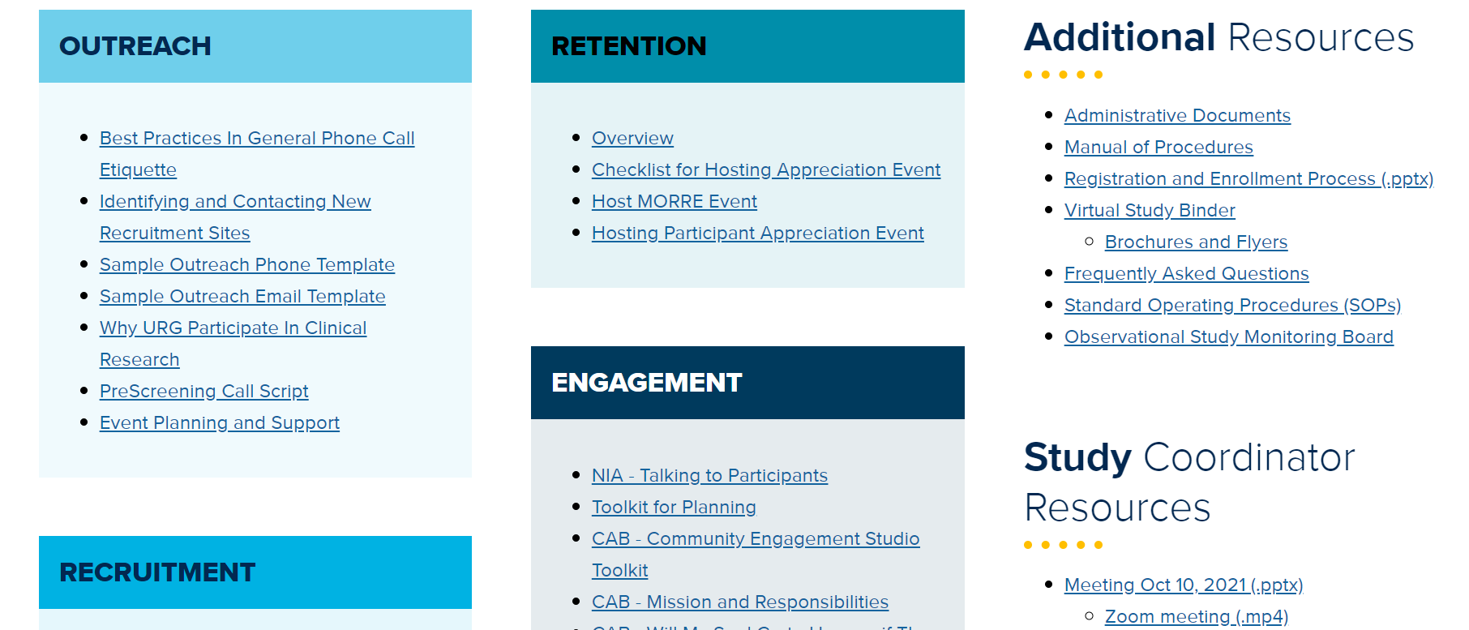
Diverse VCID Resources found here:
Diverse VCID

Slide 9

Print and post Diverse VCID flyers & posters
Add your site contact info.

Slide 10
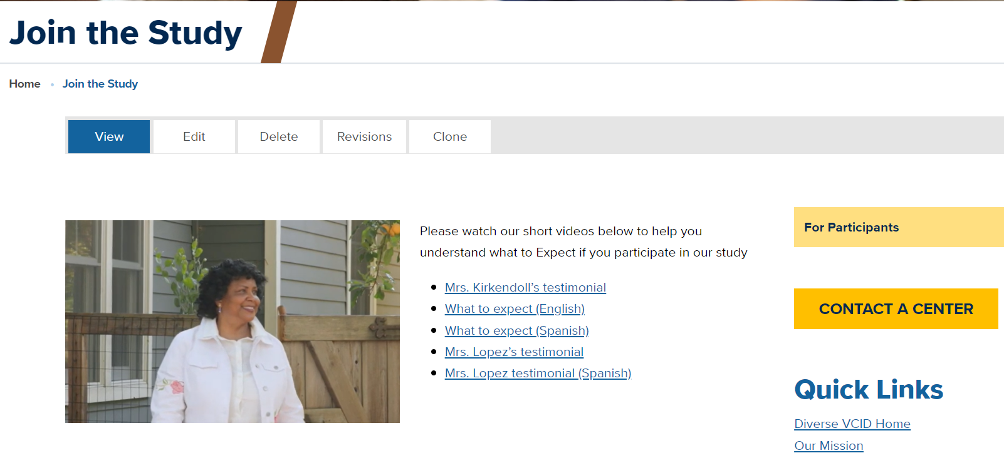
Videos on “Join the Study”

Slide 11




Registration Portal Question
Please be sure to log where the participant heard about the study
This information will inform us as to where to spend advertising $$

Slide 12
How did you hear about the Diverse VCID study?
(Added to the Registration Portal)
Is this a brand new to your ADRC/center or existing participant from another study?
  New participant
  Existing participant
How did they hear about the Diverse VCID study?
    Referred by friend, family or acquaintance
    Promotional materials (Pamphlets, brochures, flyers, videos)
    Doctor’s office
    Health fair (Public event)
    Community outreach meeting (Study sponsored event where faculty or staff present at a specific church, community center, etc.)
    Community class/educational event (Not a study sponsored event)
    Digital Media / Online Advertisement (YouTube, Podcast, Blog, Google, Facebook)
    Study Website (Study Pages or Join The Study page)
    News (TV, radio or print)
    Mail / Email
    Other (please describe):

Slide 13
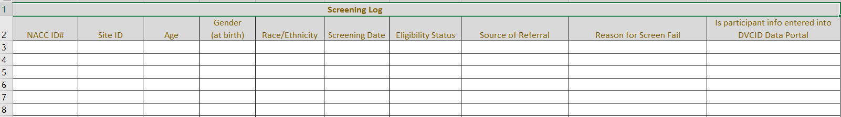
Screening Call Log
Diverse VCID For Researchers Resources
Under RECRUITMENT->Screening Call Log
Please submit with your invoices each quarter.

Slide 14
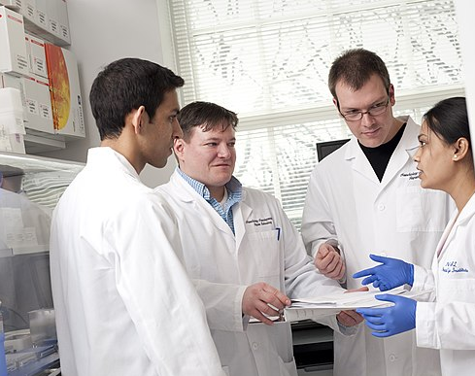
Learning Collaborative
An informal interaction of peers to share what recruiting strategies work, what barriers are we facing and how do we overcome those barriers.
Main Goal
We all learn from one another!

Slide 15
Meeting Reminders
  Any login issues with the For Researchers->Resources or Data Portal login, please reach out to Jennifer Jarrett at jjjarrett@ucdavis.edu.
  Would you be interested in joining our Learning Collaborative beginning in January/February of 2022?
Please email Gina Giambruno at ggiambruno@ucdavis.edu to be invited to the first meeting in January/February of 2022.

Slide 16


Slide 17
UC Davis Recruitment and Retention Core Contacts
David K. Johnson, PhD.
Associate Professor in Neurology
Director, UC Davis ADC - East Bay
PI, Dementia & Diabetes Prevention Project
100 N. Wiget Lane, Suite 150
Walnut Creek, CA 94598
dkj@ucdavis.edu
Gina Giambruno, MPH, MCHES®
Health Educator
UC Davis Alzheimer’s Disease Center
4860 Y Street, Suite 3900
Sacramento, CA 95817
ggiambruno@ucdavis.edu/diversevcid@ucdavis.edu

Slide 18
Co-investigators
Dr. Hector M. González
Associate Professor
University of California, San Diego
Dept of Neurosciences, School of Medicine
Dr. Lisa L. Barnes
Professor
Rush University
Department Neurological Sciences
Dr. Raina Croff
Assistant Professor of Neurology at the NIA Layton Aging and Alzheimer's Disease Center at Oregon Health & Science University

